Slide 1
Wyoming Alternate Assessment (WY-ALT) Test Administration Training
Wyoming Department of Education
Cambium Assessment, Inc.
Copyright © 2022 Cambium Assessment, Inc. All rights reserved.

Slide 2
Purpose of this Training
Explain how to access information through the Wyoming Assessment Portal;
Explain how to access information through the Test Information Distribution Engine (TIDE);
Build understanding of the different test settings and tools available for students; and
Explain how to access and administer online tests through the Test Administrator and Student Interfaces.

Slide 3
Training Objectives
Know what you must do to prepare for the WY-ALT administration;
Be familiar with the testing online systems; and
Understand what is allowed and not allowed during administration.

Slide 4
Important Information for Spring 2023 WY-ALT Assessments

Slide 5
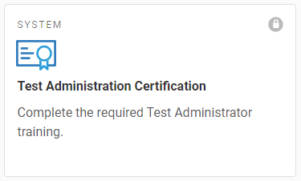
Training Requirements
In addition to this WY-ALT Training, all Spring 2023 ALT-TAs must take the online Test Administrator Certification Course, available via the WY Assessment Portal, before administering the WY-ALT Assessment.

Slide 6
Student Information
Students are added to TIDE via the nightly file upload process.
Student information is provided from each district’s Student Information System (SIS) and SPED Advantage to WDE. All information must be correct in both systems.
If any student addition or demographic change is needed, the DTC should ensure the information is correct in the SIS, then contact WDE.

Slide 7
Learner Characteristics Inventory
IEP Team should reference the WY-ALT Achievement Level Descriptors when completing the LCI.
Purpose is to describe the characteristics of students who participate in the WY-ALT Assessment and Wyoming Extended Standards (WYES);
Delivered online through the Student Interface in the Test Delivery System (TDS);
Completed by the IEP Team after completing the WY-ALT Participation Checklist or other evaluation documentation, then transcribed by the ALT-TA into the Test Delivery System (TDS);

Slide 8
Learner Characteristics Inventory (cont.)
Comprised of questions about the student’s abilities and achievement, during the calendar year;
Student does not need to be present;
Must be completed before WY-ALT test administration;
Resources can be found in the Directions for Administration Manual and the WY Assessment Portal.

Slide 9
Identifying ALT-Appropriate Students
The decision-making framework used to determine student participation in an assessment relies on the following basic assumptions:
The vast majority of students with disabilities should be able to participate in the general state assessment with appropriate accommodations, if needed.
A small number of students should participate in the WY-ALT (<1%).

Slide 10
Identifying ALT-Appropriate Students (cont.)
The WY-TOPP and WY-ALT Accommodations and Accessibility Guide describes allowable supports and accommodations for statewide assessment.
The WY-ALT Participation Guidance Manual includes decision making resources.

Slide 11
Early Stopping Rule
The Early Stopping Rule (ESR) may be engaged only after multiple administration attempts (at least three) for each subject across the breadth of the administration window. Multiple attempts should be made with consideration to the student’s availability (i.e., best time of day, best day of week, alert, with preferred staff) throughout the span of the assessment window.
Students can end the test early if:
They do not respond to the first five items in the test; or
They do respond to the first five items, but do not respond to any five consecutive items later in the test.

Slide 12
Early Stopping Rule (cont.)
ALT-TA must select the No Response option in TDS for items that the student does not respond to during the test.
Administration of at least the first five items (1-5) is required, and each of those individual items must be attempted multiple times across the entirety of the testing window before enabling the Early Stopping Rule.
First five items – After selecting No Response and clicking “Next,” TDS automatically ends test.
Five consecutive items later in test – After selecting No Response, the ALT-TA must pause and log out of TDS; do NOT select No Response for the rest of test items.
Important Note: If the No Response option is selected for a particular item(s) and the test is paused for longer than 20 minutes prior to the next administration attempt, the test will resume starting at the last unanswered item.

Slide 13
Reporting When a Student Uses the Early Stopping Rule
Contact the Wyoming Help Desk if a student uses the Early Stopping Rule. Provide the following information to the Help Desk associate:
Contact the Wyoming Help Desk (888) -897-8024;
Report student WISER ID;
Report which subject(s) early stopping rule applied;
Report number of attempts with the corresponding dates and times for each subject; and
Report the reason for ending each attempt for each subject.

Slide 14
Paper Accommodations
For students whose IEP or 504 teams have determined the student needs this accommodation;
For which subjects the accommodation is needed (i.e. ELA, Math, Science);
Typically for students needing tactile support and visual accommodations.

Slide 15
Paper Accommodations (cont.)
DTCs or BCs must flag the student as a paper tester in TIDE.
This flag will allow the student to access the fixed-form assessment.
BCs must order paper response options through TIDE during the Initial or Additional Order Windows.
These paper response options will accompany the fixed-form assessment.
Students will view the fixed-form assessment stimuli and items on the computer screen. Paper response options will correspond with the on-screen stimuli and items.
The ALT-TA is responsible for entering student responses into the system during the administration.

Slide 16
Paper Accommodations (cont.)
Initial Order Window:
January 17 – January 31, 2023
Additional Order Window:
February 21 – March 31, 2023

Slide 17
Exceptional Accommodation Requests
Exceptional Accommodations are those changes to the regular testing environment and auxiliary aids and services that that are not addressed in the WY-TOPP and WY-ALT Guidance for Accessibility and Accommodations.
Exceptional Accommodations:
Must be recommended by the student’s IEP team or 504 Plan team.
Must be submitted by the Building Coordinator or District Test Coordinator using their WyED login credentials.
Must be approved by WDE before testing begins.
Submissions must include:
Student’s WISER ID.
The requested accommodation(s).
An explanation of why the student’s need(s) may not be met with already approved accommodations in the manual.
Do not include student IEPs, 504 Plans, or any medical information.

Slide 18
Exceptional Accommodation Requests (cont.)

Slide 19
Exceptional Accommodations

Slide 20
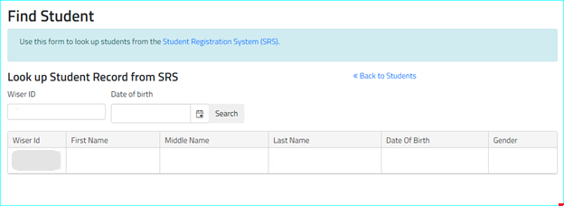
Exceptional Accommodations

Slide 21
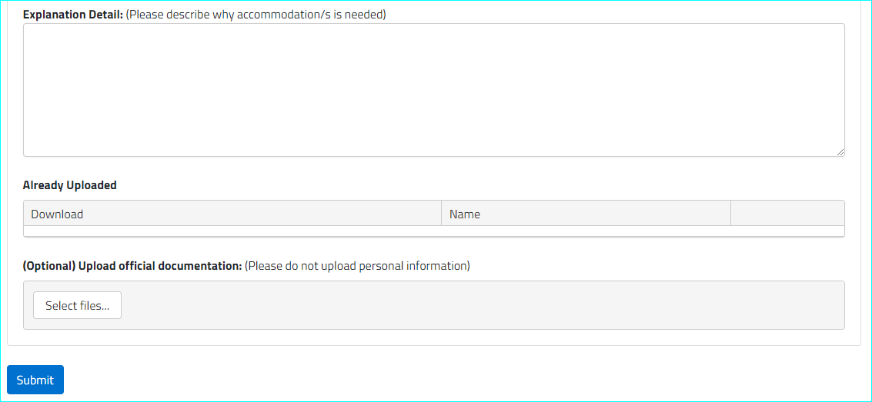
Exceptional Accommodations
Notes:
(WDE presenting)

Slide 22
Audio
Human Voice Recording (HVR) is used for WY-ALT Assessments in place of Text-to-Speech. Voice packs are no longer needed.
After listening to the HVR, the ALT-TA can read the prompt and answer choices aloud following the read-aloud protocols found in the WY Guidance for Accessibility and Accommodations.
HVR audio for stimuli, passages, item questions, and answer options must be played for all students.

Slide 23
Scoring
Responses will be collected automatically through the Test Delivery System.
All WY-ALT scores will be reported in Centralized Reporting upon test submission.
Reminder: Scores will not appear for tests using the Early Stopping Rule until the end of the testing window.

Slide 24
Spring 2023 WY-ALT Overview

Slide 25
When Is the WY-ALT Administered?
The WY-ALT Training Assessment is currently available on the WY Assessment Portal. Students and ALT-TAs may use the Training Test to review sample item types, practice responding to items, and become familiar with online test navigation, accommodations, and tools.
WY-ALT Test Window:
February 28 – April 7, 2023

Slide 26
WY-ALT Assignment by Grade
Student Grade | Content Areas to be Administered to Each Student
3 | English Language Arts and Mathematics
4 | English Language Arts, Mathematics, and Science
5 | English Language Arts and Mathematics
6 | English Language Arts and Mathematics
7 | English Language Arts and Mathematics
8 | English Language Arts, Mathematics, and Science
9 | English Language Arts and Mathematics
10 | English Language Arts, Mathematics, and Science

Slide 27
WY-ALT Test Design
Spring 2023 Computer-Adaptive Test (CAT):
For the Spring 2023 WY-ALT test administration, Computer-Adaptive Tests (CAT) will include 40 test items.
Items developed by Wyoming, South Carolina, Hawaii, Idaho, South Dakota, and Montana.
WY-ALT blueprints are available on the WDE website: https://edu.wyoming.gov/.

Slide 28
How is the WY-ALT Administered?
ALT-TAs should verify that the correct accommodations for each student are selected in TIDE.
The WY-ALT is administered through the Test Delivery System (TDS). TDS requires two machines (e.g., computers, tablets):
One for the Test Administrator (TA) Interface – machine needs a web browser;
Second for the Student Interface – machine needs the Secure Browser downloaded via the WY Assessment Portal (wyoassessment.org).
ALT-TAs must complete the online LCI prior to testing. This will not be available until the administration window opens. The student does NOT need to be present for entries in the LCI. Testing accommodations must be present on an IEP or 504 Plan and entered into TIDE.

Slide 29
How is the WY-ALT Administered? (cont.)
The purpose of the Learner Characteristic Inventory (LCI) is to describe the characteristics of students who participate in the Alternate Assessment and Wyoming Extended Standards. The LCI is completed by the IEP team, and the online questionnaire must be completed by ALT-TAs for each student before administering the WY-ALT Assessment to them.

Slide 30
How is the WY-ALT Administered? (cont.)
The student will take the WY-ALT Assessment using a computer or tablet with the Secure Browser installed.
The Technology Coordinator is responsible for ensuring that the Secure Browser has been downloaded and correctly installed on all testing devices before testing begins.

Slide 31
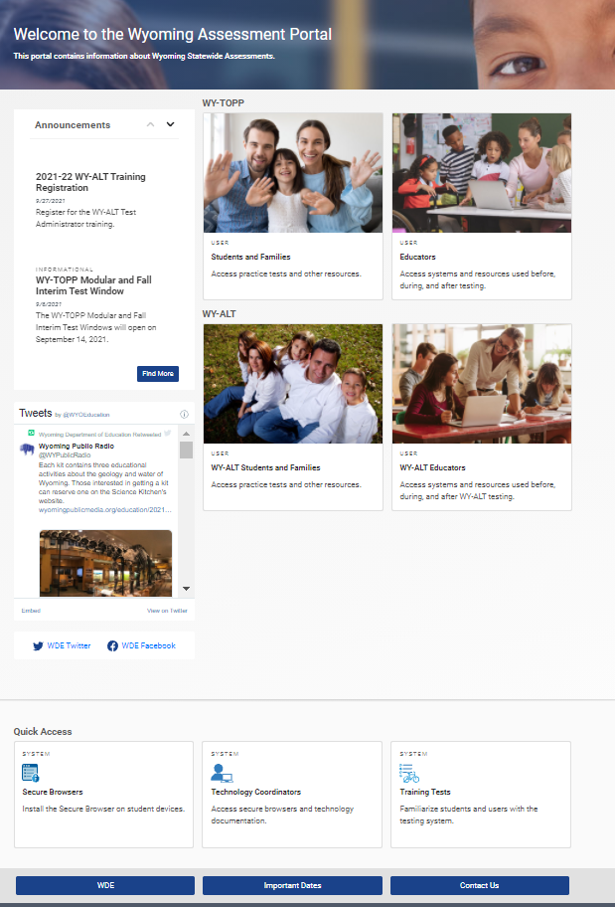
Secure Browser

Slide 32
How is the WY-ALT Administered? (cont.)
The ALT-TA will use a second computer to start and monitor the test session via the TA Interface.
Throughout test sign-in and administration, ALT-TAs may support students in navigating throughout the assessment.

Slide 33
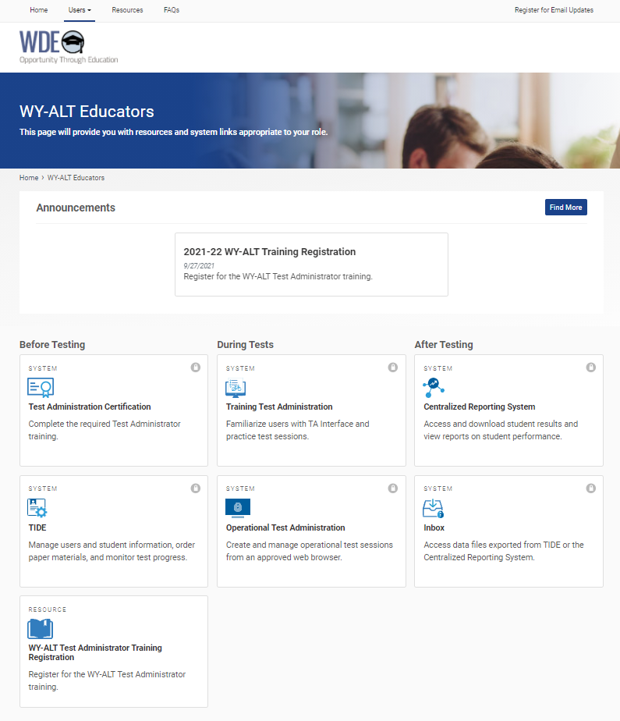
TA Interface

Slide 34
Sign-In (Student Interface)

Slide 35
Student Look Up Tool
Operational Session ID

Slide 36
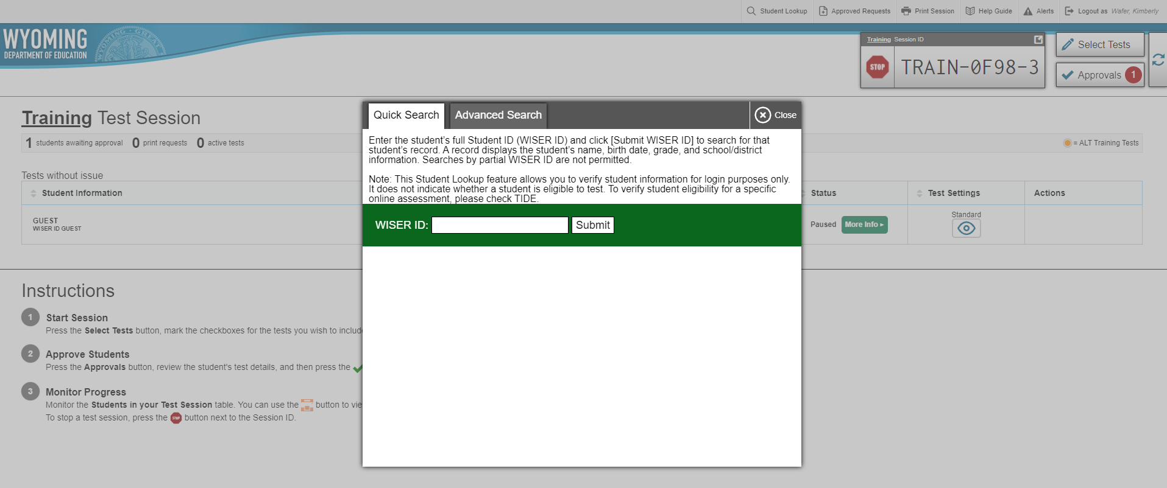
Student Look Up Tool (cont.)

Slide 37
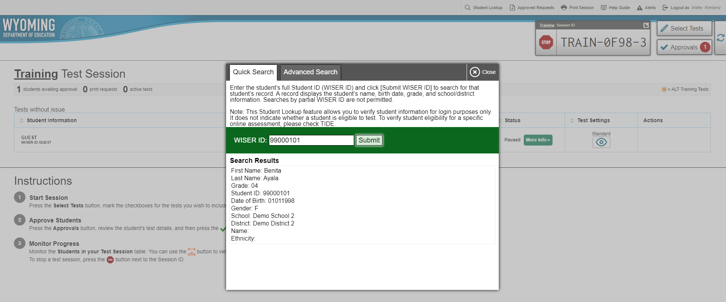
Student Look Up Tool (cont.)

Slide 38
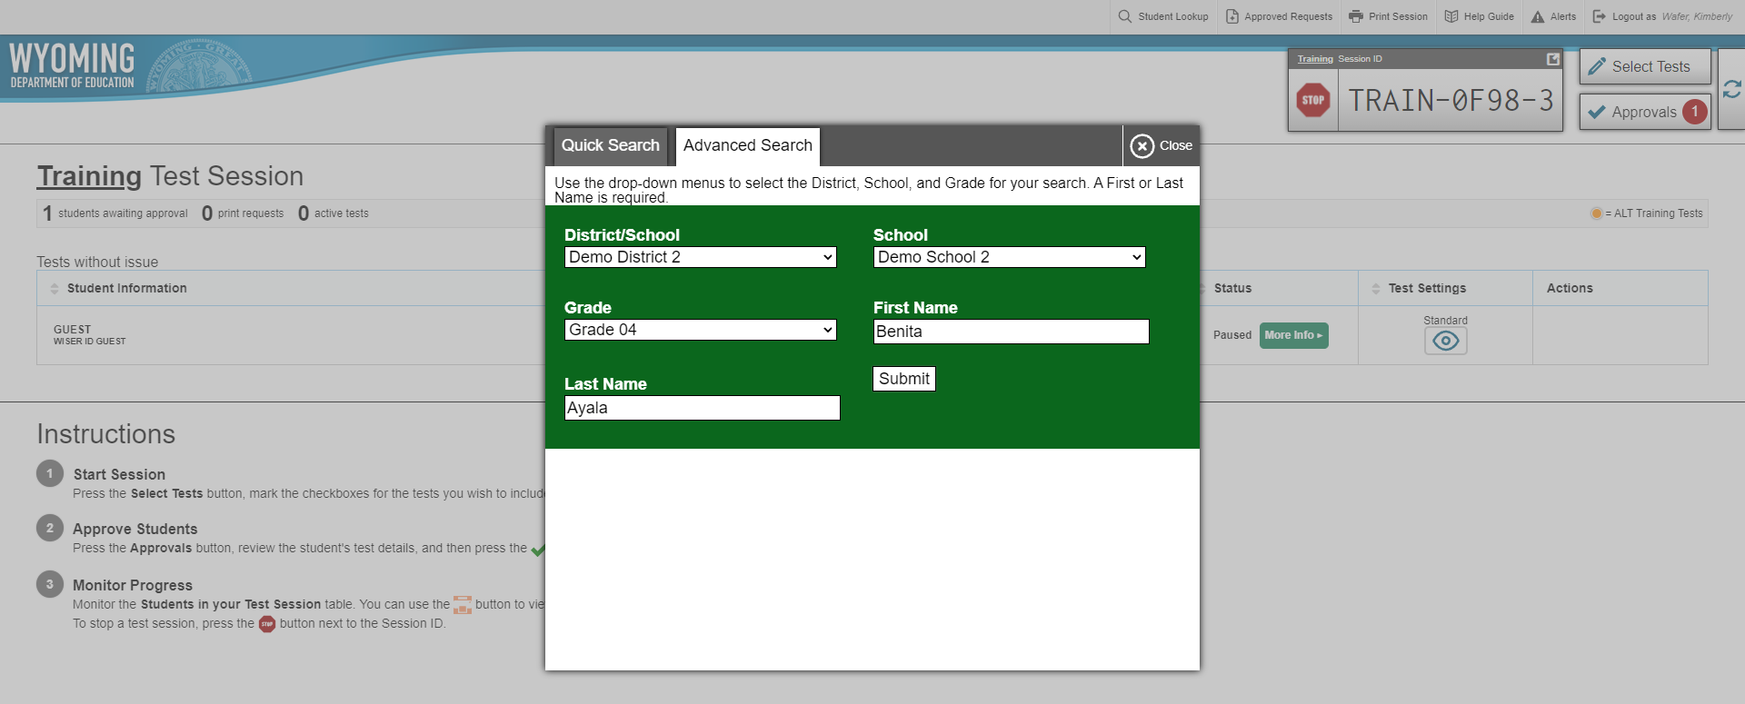
Student Look Up Tool (cont.)

Slide 39
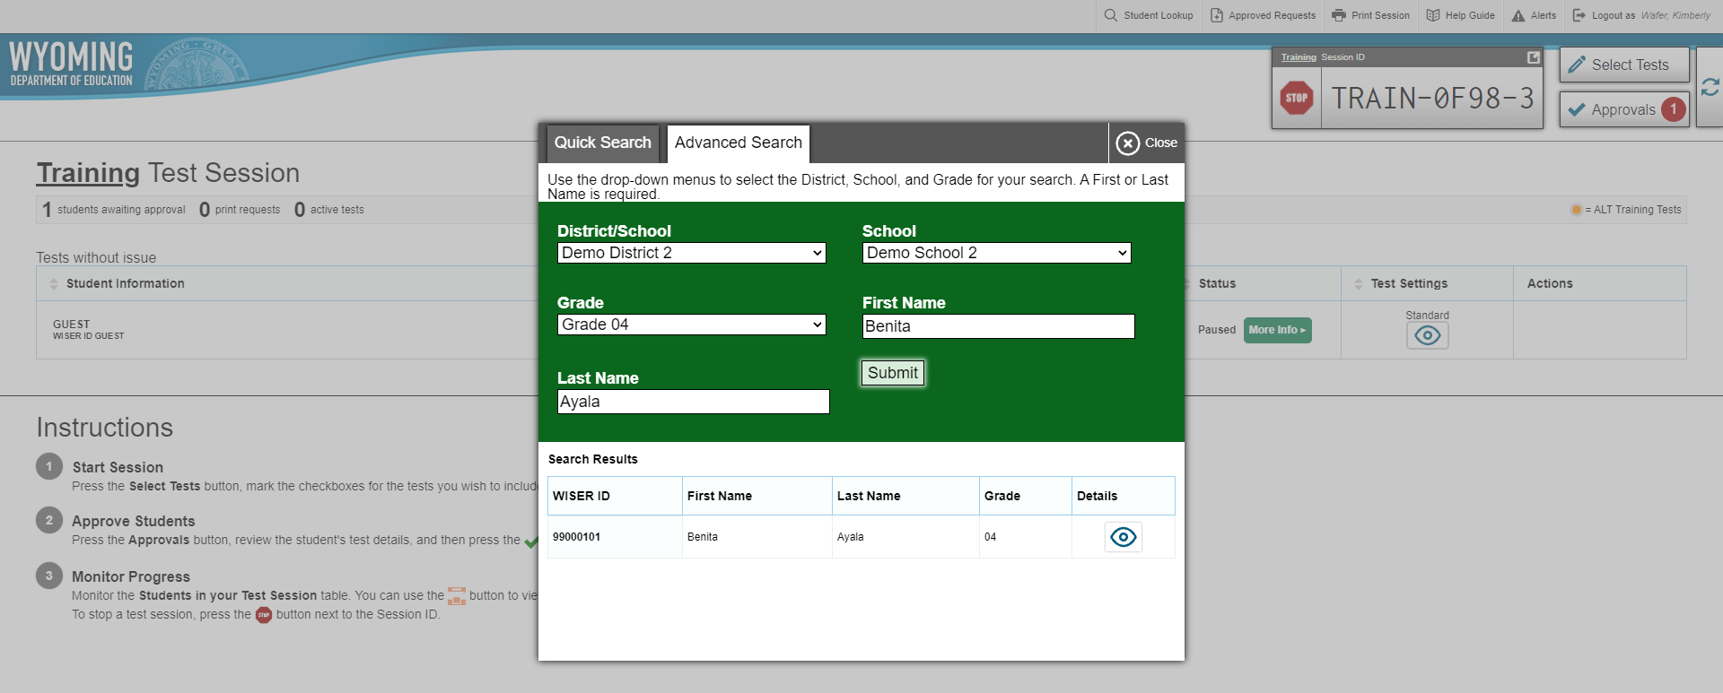
Student Look Up Tool (cont.)

Slide 40
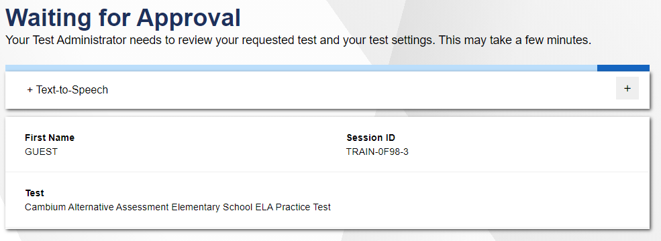
Sign-In (Student Interface)

Slide 41
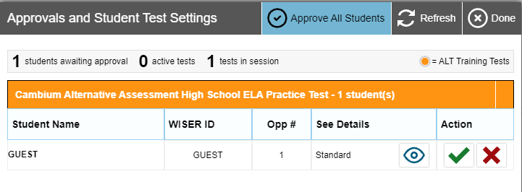
TA Interface Dashboard

Slide 42
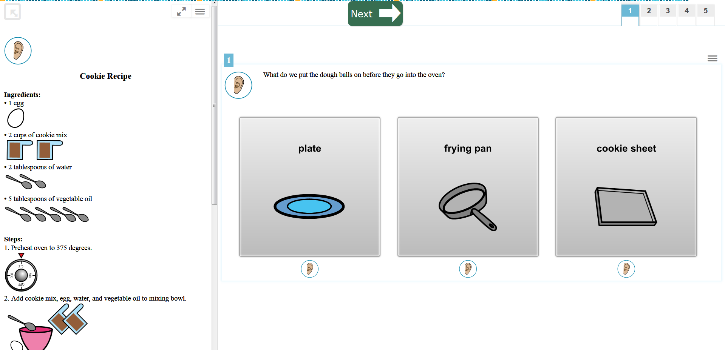
Student Interface

Slide 43
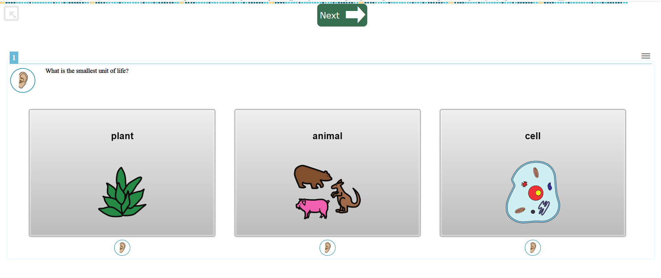
Student Interface (cont.)
Note: To access the global tools menu during a test, you must exit Full Screen Mode.

Slide 44
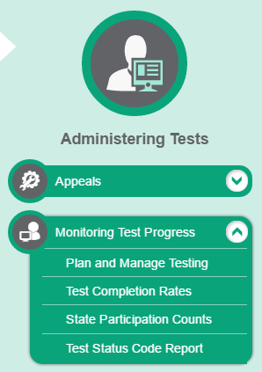
Monitoring Test Progress in TIDE
Several types of participation reports are available:
Plan and Manage Testing Report: Details all of a student’s test opportunities and the status of those test opportunities.
Test Completion Rates Report: Summarizes the number and percentage of students who have started or completed a test.
Test Status Code Report: Displays all the non-participation codes for a test administration.

Slide 45
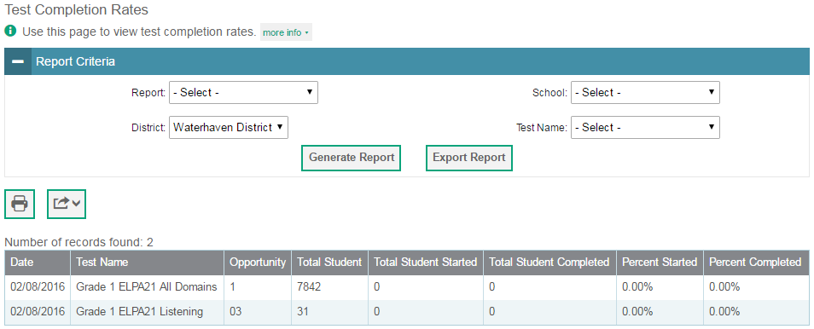
Monitoring Test Progress in TIDE

Slide 46
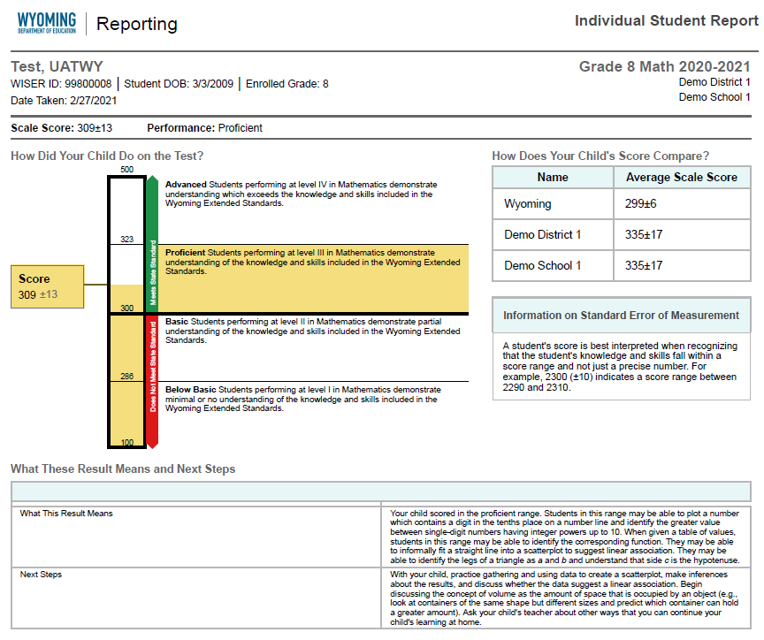
Centralized Reporting
Same login as TIDE;
All WY-ALT scores will be reported in Centralized Reporting upon test submission.
Downloadable data files will include test scores and demographic information.

Slide 47
Centralized Reporting (cont.)
Retrieve Student Results
Downloadable data files;
PDFs of individual student reports for entire school/district.
View Score Reports
Subject Detail Reports – how students for district/school/teacher have performed;
Trend Reports – how students performed across multiple years; and
Student Detail Reports – immediately available student scale score and performance level, with what results mean and next steps;
Access Centralized Reporting and resources (tutorials, user guides) via the WY Assessment Portal (https://wyoassessment.org/).

Slide 48
Contact Your Help Desk
You can contact the Wyoming Help Desk for assistance with any technical issues you encounter. When contacting the Help Desk, please be ready to provide the following information:
Any error messages that are appearing (including codes);
Your operating system and browser information;
Your network configuration information;
Your contact information for follow-up by telephone or email; and
Any other relevant information, such as test names or content areas, student IDs, session IDs, and search criteria.
For test administration or policy issues, please contact your District Test Coordinator.

Slide 49
Path to Success
Read the Directions for Test Administration Manual (DFAM) and WY-ALT Helpful Tips;
Plan for administration; and,
Contact the Wyoming Help Desk if you have questions.

Slide 50
For More Information
Resources on the WY Assessment Portal
https://wyoassessment.org/
Manuals
User Guides
Quick Guides
Tutorials
Training slides and recordings
FAQs
Resources on the WDE website
https://edu.wyoming.gov/
Blueprints
Training Registration
Assessment calendar
Assessment newsletters
Wyoming Help Desk
(888) 897-8024
wyohelpdesk@cambiumassessment.com

Slide 51
Thank you for attending this training session!

