Slide 1
Data Entry Interface (DEI) For Paper and Braille Test Administrations
Training Module
2023 – 2024
Copyright © 2021 Cambium Assessment, Inc. All rights reserved.
Notes:
In this training module, we will discuss how to use the Data Entry Interface (DEI) to enter student responses on paper-based accommodated test form.
This module covers information that Test Administrators (TAs) should be aware of before using the Data Entry Interface. For more detailed information on using the DEI, please refer to the Data Entry Interface User Guide available on your state’s portal.

Slide 2
Module Objectives
After viewing this presentation, you should be able to:
Understand what the Data Entry Interface (DEI) is and how to access it.
Enter student responses into the DEI.
Use the different features available in the DEI.
Notes:
After viewing this presentation, you should be able to:
Understand what the Data Entry Interface is and how to access it
Enter student responses into the DEI and
Use the different features available in the DEI

Slide 3
How the DEI is Used
The DEI can be used for both paper and braille test administration to enter and transcribe student responses for all other test items .
Notes:
The DEI is used to enter student responses for students taking the test in paper and braille forms. The DEI is also used to record responses to the speaking test for students who take the test using paper and braille forms.

Slide 4
Confirming Student Settings in TIDE
TIDE is the “home” for all student data and accommodations.
Before a TA can enter data for a student into the DEI, that student’s record should be checked in TIDE to ensure that the correct flag has been set for a paper or braille form.
Domain exemptions must be marked in TIDE prior to paper testing and data entry.
Notes:
For the TA to enter data for a student in the DEI, the student’s record in TIDE needs to be updated to allow for a paper or braille form. TIDE is the “home” for all student data and accommodations. That student’s record should be checked in TIDE to ensure that the correct flag has been set for a paper or braille form. The TIDE User Guide has more information about how to do this.

Slide 5
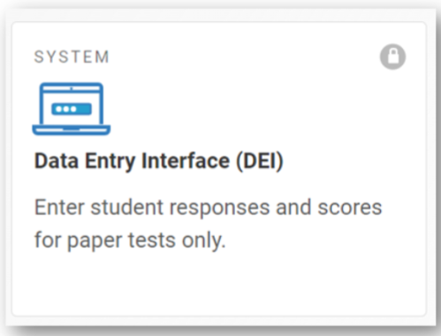
Accessing the Data Entry Interface
To access the DEI, navigate to the Teachers and Test Administrators page on the portal, and select the Data Entry Interface icon.
Notes:
For paper and braille testing, the TA should log into the system in preparation for administering the speaking test items.
To access the DEI, navigate to the Teachers and Test Administrators page on the portal and select the “Data Entry Interface” icon.

Slide 6
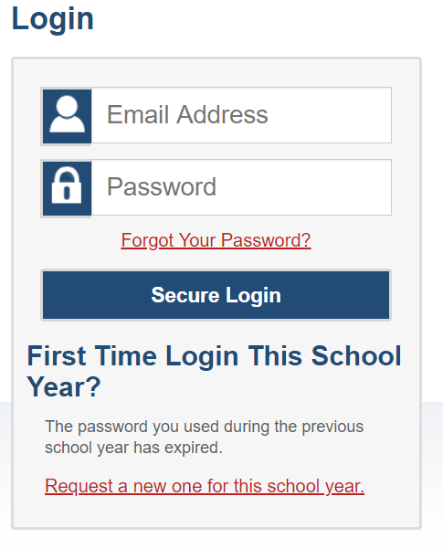
Accessing the Data Entry Interface
Log in with your username and password.
Notes:
Log in with your username and password. This is the same username and password you use to access all Cambium Assessment, Inc. (CAI) systems including TIDE and the Test Administrator Interface.

Slide 7
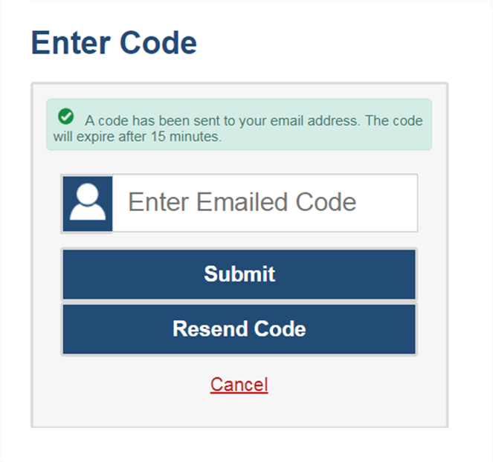
Accessing the DEI, continued
The system has an authentication process that will be triggered when you log in from a different device or browser or after clearing your browser’s cache.
If you see this screen, an email containing the code will have been sent automatically to your email address.
Enter the code and click Submit.
If you need the code to be resent, click Resend Code.
Notes:
When logging in to the system using a new device or browser, or after clearing the cache on a previously used browser, you will see an Enter Code page.
If you see this screen, will need to enter the code on this page within 15 minutes of receiving the email. If you do not receive a code or do not enter the code within the 15-minute time limit, click Resend Code. Click Submit after entering the authentication code to access the system. You will be taken to the Reset Your Password page that was presented at the beginning of this module.

Slide 8
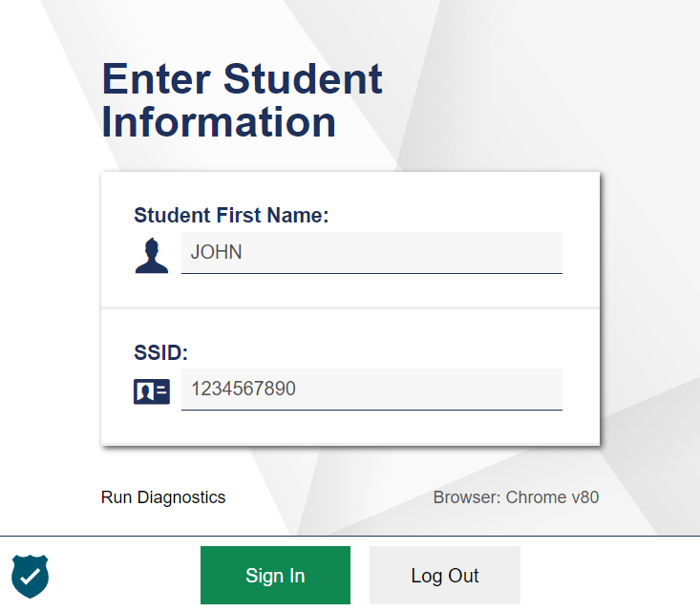
Accessing the Data Entry Interface
You will be prompted to enter information for the student you are testing.
Enter the student’s first name and student ID, and then click Sign In.
Notes:
After logging in to the DEI, you will be prompted to enter information for the student you are testing. Enter the student’s first name and student ID number. Please note that the student’s first name and ID must match what is pre-identified in TIDE. If the student does not have a permanent student ID yet, then you should enter the temporary ID listed for the student in TIDE. For information about registering students in TIDE, please consult your TIDE User Guide.
When you have entered the information, click Sign In.

Slide 9
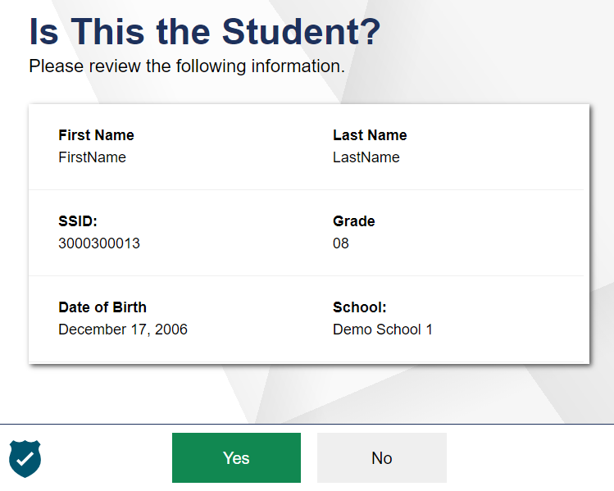
Accessing the Data Entry Interface
Verify that the student’s demographic information is correct.
If all the student’s information is correct, click YES. If any information is incorrect, click NO and then contact your test coordinator.
Notes:
Next, you will be prompted to verify that the student’s demographic information is correct. Please be sure to review every field. If all the student’s information is correct, click YES. If any information is incorrect, click NO, and contact your test coordinator.

Slide 10
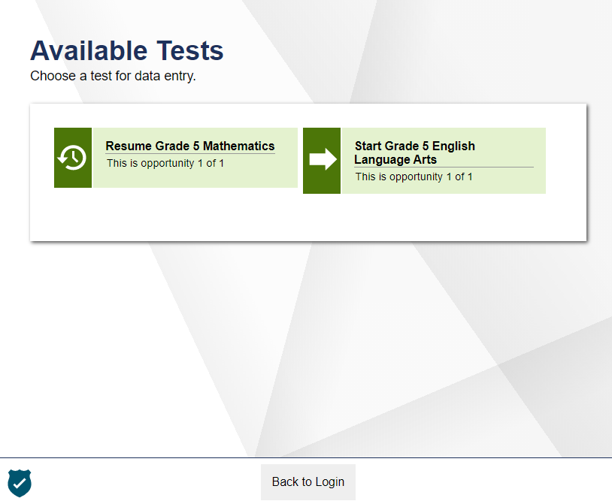
Test and Form Selection
Notes:
After verifying the student’s information, the Available Tests screen will appear. Please note two things about this page:
First, the page lists the tests available for the student based on the student’s grade level. Please verify that the appropriate test is listed for the student. If the test for this student is missing or incorrect, please contact your test coordinator.
Second, the arrows on this page signal the test’s status. A solid background indicates that the test has not been started and no data has been entered. A clock face shaped arrow indicates that the test has been started, but still needs to be reviewed and submitted.

Slide 11
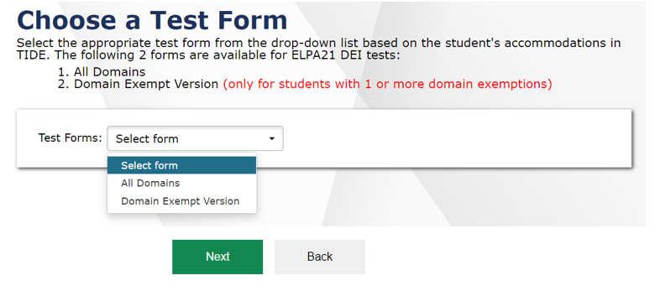
Test and Form Selection
Select the correct form from the Test Forms drop-down menu.
After you select the test form, select Next to proceed.
Note: When entering data for a Braille paper tester, verify that the student’s presentation is set to Braille in TIDE before selecting the Braille test form in DEI.
Notes:
On the next page, select the correct form from the Test Forms drop-down menu.
For Paper Tests: Choose “All Domains” for students without domain exemptions or choose “Domain Exempt Version” for students with exempted domains.
For Braille Tests: There is only one form to select. Choose the option in the test forms drop-down menu.
After you select the test form, click Next to proceed.

Slide 12
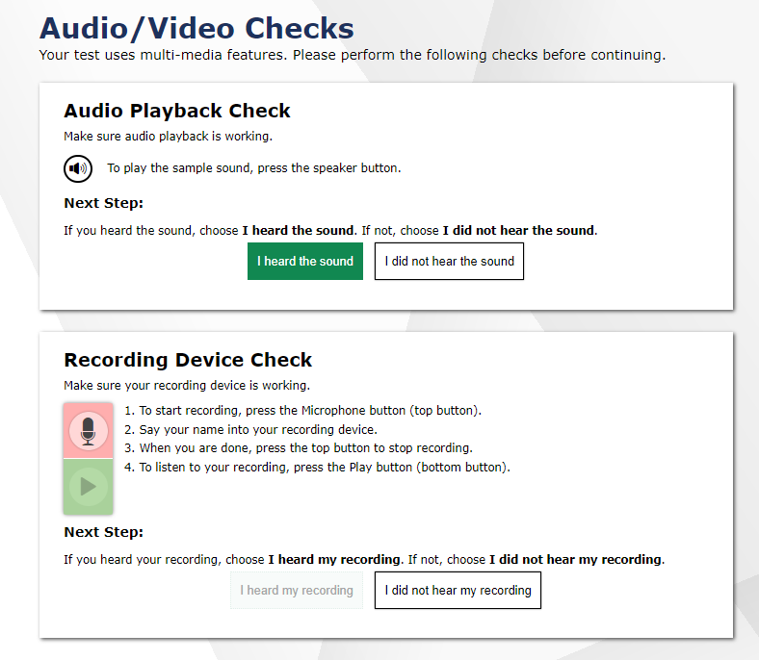
Audio/Video Checks
Notes:
If required by the test content or specified test settings, you may will see an Audio/Video Checks page where you will need to perform functional checks to ensure the testing devices are working properly. Depending on the test, you may see one or more panels. We will walk through these audio/video checks in the next few slides.

Slide 13
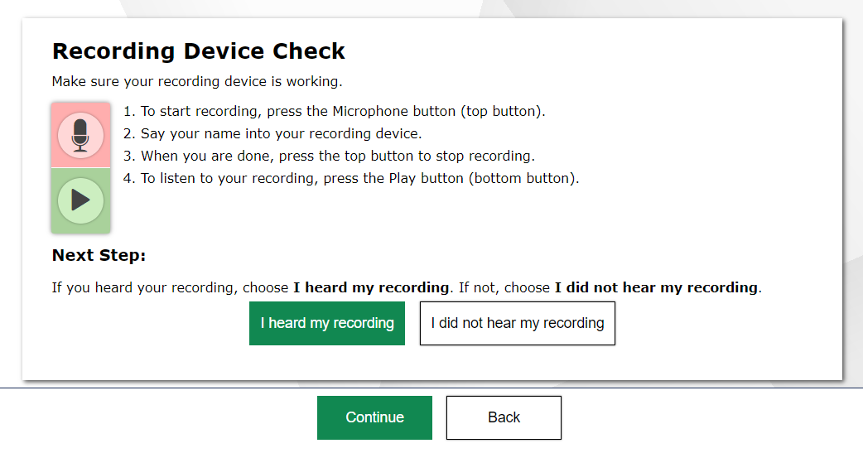
Recording Device Check
Start/Stop Recording
Start/Stop Playback
Notes:
You may also be asked to verify that your recording device is functioning.
To continue, select the microphone icon on this panel. You should say your name into the recording device, and then select the top button again to stop recording.
After stopping recording, select the bottom button to play back the recording.
If you clearly hear the recording, select I heard my recording. Then select Continue to proceed to the test.
If the audio is not clear, select I did not hear my recording and then select Try Again to record an audio sample again. You can choose Select New Recording Device to try recording using a different attached audio device or select Logout to leave the test and adjust the recording device settings.
When all audio checks are complete, select Continue.

Slide 14
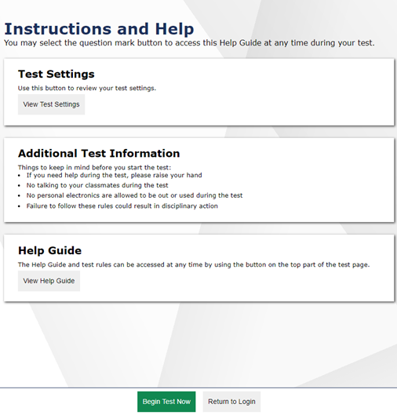
Instructions and Help
Before beginning data entry, the Instructions and Help page will appear.
The Help Guide will bring up content that explains the Test Rules and gives an overview of the Data Entry Interface.
The Test Settings will show the student’s test settings.
Some important reminders are listed under Additional Test Information.
Selecting the Begin Test Now button will take you to the first question of the test. You may select the question mark button to access this Help Guide at any time during the test.
Notes:
Before beginning data entry, the Instructions and Help page will appear.
The Help Guide will bring up content that explains the Test Rules and gives an overview of the Data Entry Interface.
The Test Settings will show the student’s test settings.
Some important reminders are listed under Additional Test Information.
Selecting the Begin Test Now button will take you to the first question of the test. You may select the question mark button to access this Help Guide at any time during the test.

Slide 15
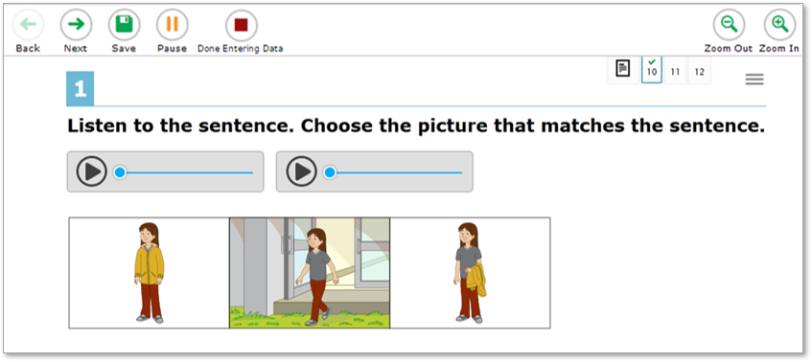
Entering Data into the DEI
After selecting Begin Test Now, you will see the data entry page for an item. Similar to the test booklet, the item questions are presented in bold text. This screenshot shows you an example of what a listening item looks like.
Notes:
After selecting Begin Test Now, you will see the data entry page for an item. Similar to the test booklet, the item questions are presented in bold text. This screenshot shows you an example of what a listening item looks like.
The data entry page will display one item at a time within a task. Notice the numbered tabs at the top right corner of the screen. These tabs represent items associated with the task. A green checkmark will appear in each tab after data has been entered for that item. You can use the green arrow buttons labeled Back and Next in the upper-left corner of the screen to move between the items of a task. You can also jump directly to a specific task using the Questions drop-down menu.

Slide 16
Entering Data into the DEI
The data entry page will display one item at a time within a task. Notice the numbered tabs at the top right corner of the screen. These tabs represent items associated with the task.
A green checkmark will appear in each tab after data has been entered for that item. You can use the green arrow buttons labeled Back and Next in the upper-left corner of the screen to move between the items of a task. You can also jump directly to a specific task using the Questions drop-down menu.
Notes:
After selecting Begin Test Now, you will see the data entry page for an item. Similar to the test booklet, the item questions are presented in bold text. This screenshot shows you an example of what a listening item looks like.
The data entry page will display one item at a time within a task. Notice the numbered tabs at the top right corner of the screen. These tabs represent items associated with the task. A green checkmark will appear in each tab after data has been entered for that item. You can use the green arrow buttons labeled Back and Next in the upper-left corner of the screen to move between the items of a task. You can also jump directly to a specific task using the Questions drop-down menu.

Slide 17
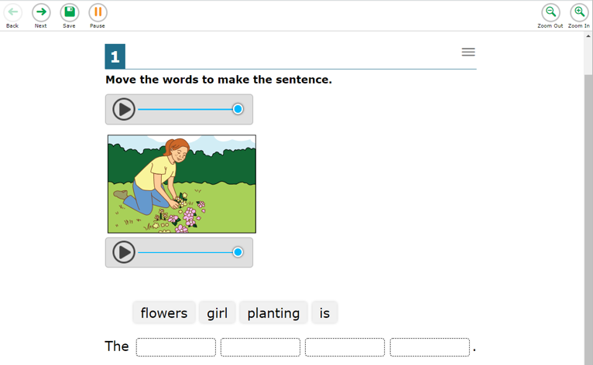
Entering Data into the DEI, continued
The Save button can be used to save a response, but is not necessary to use since responses are automatically saved upon selection.
The Pause button is used to pause the data entry session without submitting the test, so you can continue entering data at a later time.
You can use the Zoom Out and Zoom In buttons at the top right of the screen to magnify text and images.
Please note that the DEI is designed to look similar to the online test students see when testing online, therefore students may have additional tools and accommodations available. These tools and accommodations are not necessary for TA’s to use when using the DEI.
For each task and item, enter the response given by the student. As soon as the answer is selected, the DEI immediately saves it.
Notes:
The Save button can be used to save a response, but is not necessary to use since responses are automatically saved upon selection.
The Pause button is used to pause the data entry session without submitting the test, so you can continue entering data at a later time.
You can use the Zoom Out and Zoom In buttons at the top right of the screen to magnify text and images.
Please note that the DEI is designed to look similar to the online test students see when testing online, therefore students may have additional tools and accommodations available. These tools and accommodations are not necessary for TA’s to use when using the DEI.
For each task and item, enter the response given by the student. As soon as the answer is selected, the DEI immediately saves it.

Slide 18
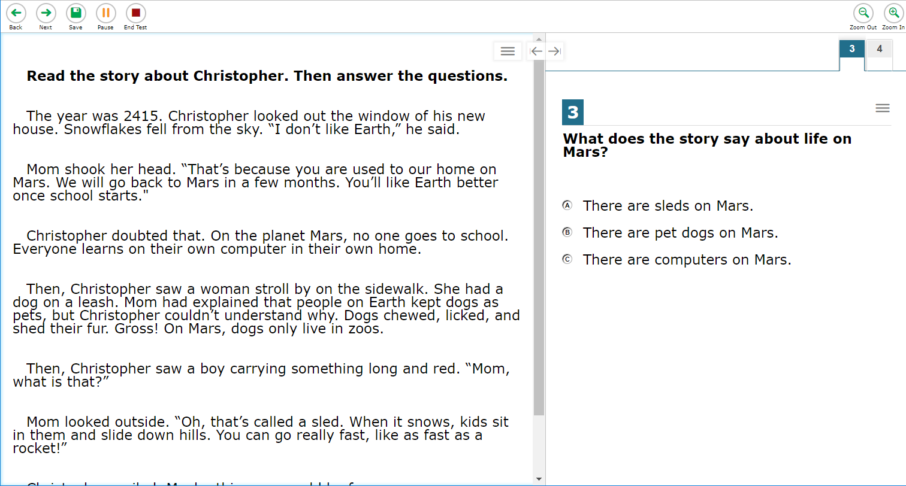
Entering Student Response Data Paper Administration
When entering the paper administration data for the multiple choice Listening, Reading, and Writing sections, students mark their responses in their test booklet. At the conclusion of the testing session, the TA will input the student’s responses into the DEI.
For the Writing constructed response & word and sentence builder section, the TA will copy the student’s response from the test booklet into the DEI for scoring. For the word & sentence builder items, the TA will drag and drop the response tiles to match the student’s response exactly.
For the constructed-response items, the TA will use the DEI to transcribe the student’s written responses verbatim.
Notes:
When entering the paper administration data for the multiple choice Listening, Reading, and Writing sections, students mark their responses in their test booklet. At the conclusion of the testing session, the TA will input the student’s responses into the DEI.
For the Writing constructed response & word and sentence builder section, the TA will copy the student’s response from the test booklet into the DEI for scoring. For the word & sentence builder items, the TA will drag and drop the response tiles to match the student’s response exactly.
For the constructed-response items, the TA will use the DEI to transcribe the student’s written responses verbatim.
For the Speaking section, the TA will record the student’s spoken responses directly into the DEI during testing.

Slide 19
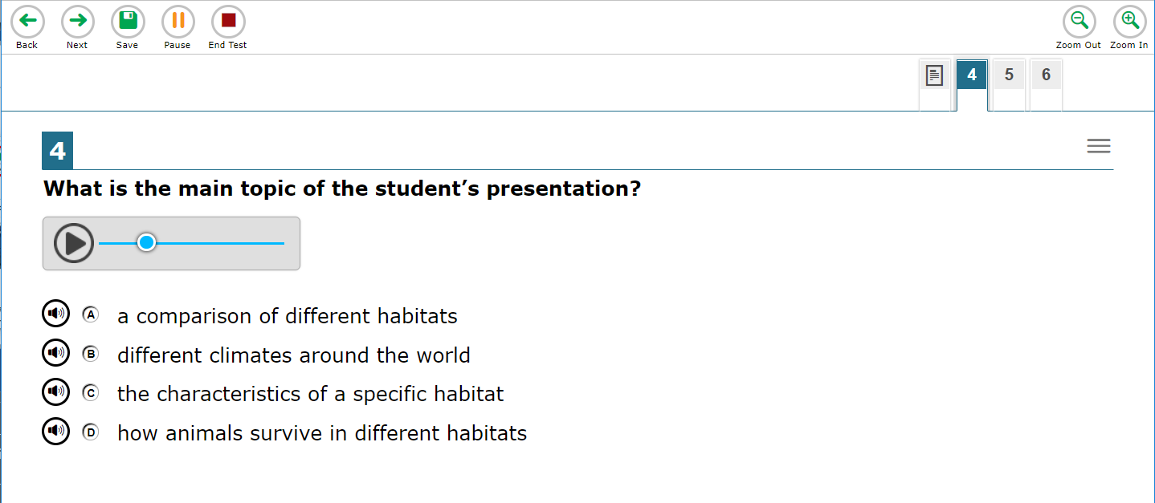
Entering Student Response Data: Braille Administration
Notes:
When entering the braille administration data for the multiple choice Listening, Reading, and Writing sections, the test administrator should mark the student’s indicated responses in the DFA. At the conclusion of the testing session they will enter the student’s responses into the DEI.
For the Writing section, if the student is able to use a braille writing device to respond, the TA will administer the Writing test items labeled “DEVICE.” After the test is complete, the TA will print the responses, and then transcribe the printed responses verbatim into the DEI.
If the student does not have a braille writing device or is not yet proficient with one, the TA will administer the Writing test items labeled “ACCESSIBLE.” Those responses will be scribed by the TA. Then the TA will type the scribed responses verbatim into the DEI.
When entering braille administration data for the Speaking section, the TA will record the student’s spoken responses directly into the DEI during testing.

Slide 20
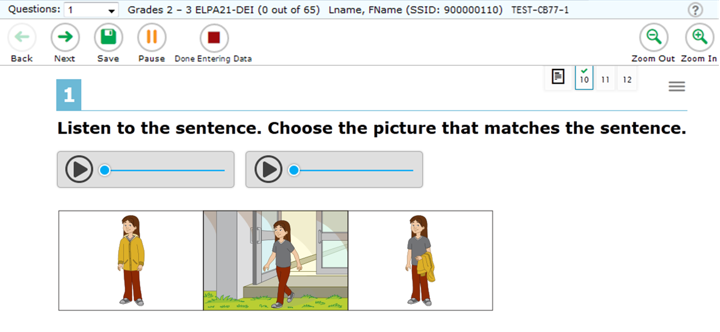
Submitting the Test: New Workflow
After completing data entry, be sure to review all entered data. Follow the instructions provided in the Directions for Administration Manual.
When you have checked all responses you have entered and are ready to submit the test, click the red Done Entering Data button to continue.
Notes:
After completing data entry, be sure to review all entered data. Follow the instructions provided in the Directions for Administration Manual.
When you have checked all responses you have entered and are ready to submit the test, click the red Done Entering Data button to continue.
If you are not ready to submit answers at this time, click the Pause button to save your work and navigate away from the system. In the process, you will be logged out of this student’s data entry session. If you choose to pause your session, remember to complete data entry and submit the test by the end of the administration window.
Please note that you must click the Done Entering Data button in order to submit scores. You will be asked to confirm that you would like to submit the test. Click Yes to continue.

Slide 21
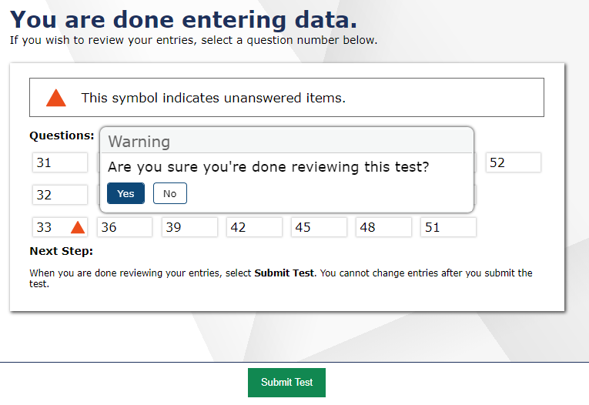
Review and Submit
You will receive one more opportunity to review your entries.
You may review your entries again or submit the test for scoring.
Click Submit Test and Yes to complete the submission process.
Notes:
On the next page, you’ll receive a final opportunity to review your entries before submitting the test for scoring. Each unanswered question has an orange icon beside it. Both answered and unanswered questions are available for review. To review a question, click a question number. You may click the Done Entering Data button at any time during the review process to return to this page.
If the test is ready for submission, click the Submit Test button. A pop-up window will ask you to confirm that you are done reviewing. Click Yes to submit the test. If you do not submit the student’s test, the test will be paused. Be aware that in some states, paused tests are automatically submitted at the end of the day or at the end of the following day. If a student’s test is auto-submitted before all responses have been entered, then an appeal will need to be created in TIDE for that test to be reopened. For information about creating appeals, see the TIDE User Guide. Once submitted, the student’s scores are final.
If the test was administered or submitted in error, your test coordinator may invalidate it after submission. Please consult your test coordinator if you believe that test answers were submitted in error.

Slide 22
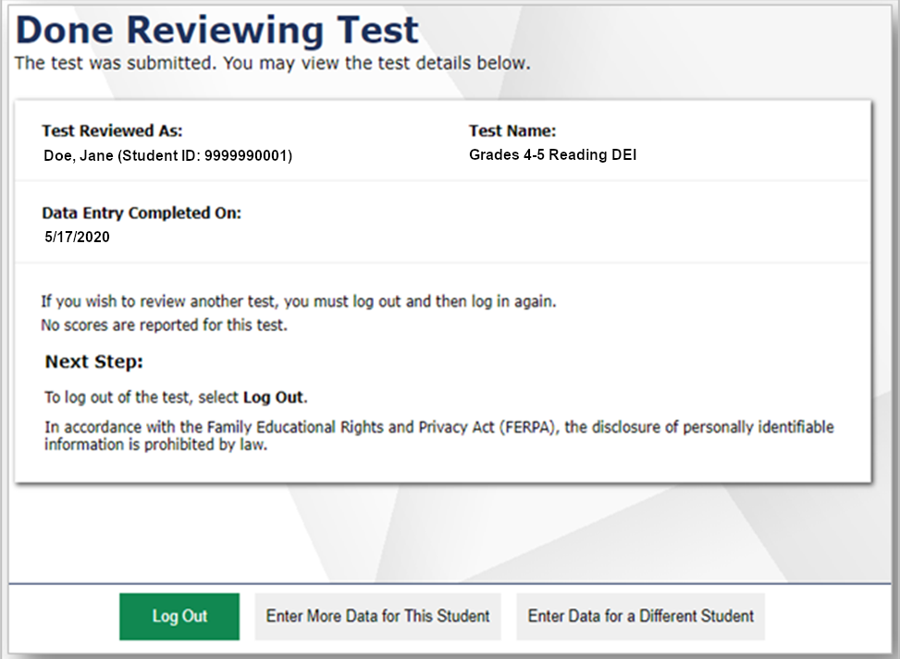
Submitting the Test
The next screen will confirm that the student’s test has been submitted .
From here, you may choose to log out or enter data for a different student.
Notes:
The next screen will confirm that the student’s test has been submitted .
From here, you may choose to log out or enter data for a different student.

Slide 23
Helpful Hints
If your state allows it, you may skip items that the student has not answered by clicking the Next button.
Questions may appear differently in the DEI from how they appear in the paper test booklets:
Instead of circling a letter, you may need to click on a word or image.
Instead of drawing a line between two objects, you may need to drag and drop one object on top of the other.
Instead of filling in a blank, you may need to choose an answer from a drop-down list.
Notes:
Here are some helpful hints to assist you with entering student responses in the DEI.
If your state allows it, you may skip items that the student has not answered by clicking the Next button.
Questions may appear differently in the DEI from how they appear in the paper test booklets. It is important to emulate in the DEI how the student responded in the paper test booklet. For example:
Instead of circling a letter, you may need to click on a word or image.
Instead of drawing a line between two objects, you may need to drag and drop one object on top of the other.
Instead of filling in a blank, you may need to choose an answer from a drop-down list.
Finally, for a test with domain exemptions to be scored correctly, note that the exempted domain(s) must be selected in TIDE, and all the questions in this domain must be skipped while the test is being transcribed into the DEI. If any questions are answered in a domain, it will be scored and reported, even if the student is exempted from that domain in TIDE.

Slide 24
Helpful Hints
For a test with domain exemptions to be scored correctly, the exempted domain(s) must be selected in TIDE, and all the questions in this domain must be skipped while the test is being transcribed into the DEI. If any questions are answered in a domain, it will be scored and reported, even if the student is exempted from that domain in TIDE.
Notes:
Here are some helpful hints to assist you with entering student responses in the DEI.
If your state allows it, you may skip items that the student has not answered by clicking the Next button.
Questions may appear differently in the DEI from how they appear in the paper test booklets. It is important to emulate in the DEI how the student responded in the paper test booklet. For example:
Instead of circling a letter, you may need to click on a word or image.
Instead of drawing a line between two objects, you may need to drag and drop one object on top of the other.
Instead of filling in a blank, you may need to choose an answer from a drop-down list.
Finally, for a test with domain exemptions to be scored correctly, note that the exempted domain(s) must be selected in TIDE, and all the questions in this domain must be skipped while the test is being transcribed into the DEI. If any questions are answered in a domain, it will be scored and reported, even if the student is exempted from that domain in TIDE.

Slide 25
Thank You!
For additional information, please visit wyoassessment.org page, which contains:
DEI User Guide
Directions for Administration
For further assistance, please contact the Wyoming Help Desk.
Wyoming Help Desk
(888) 897-8024
wyohelpdesk@cambiumassessment.com
Notes:
Thank you for viewing this training module. If you need additional information, please visit your state’s portal, where you can find announcements and copies of the DEI User Guide. Remember to follow the secure Directions for Administration document you received with the student’s paper test while administering these tests for guidance.
For further assistance, please consult your Help Desk.

